Slide 1

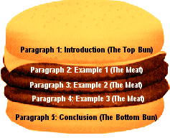

Slide 2


Opinion essays are discursive essays in which you
present your personal opinion on a particular topic.
Your opinion must be stated clearly and supported
by justifications. You should also present the
opposing viewpoints in a separate paragraph.

Slide 3




An opinion essay should consist of:
Introduction
Introduces the subject and states your opinion clearly.
Main Body
Consists of two or more paragraphs. Each viewpoint supported by a logical reasons, should be presented in a separate paragraph.
The opposing viewpoint is mentioned in a new paragraph.
Conclusion
Sums up your viewpoint and restates the opinion using different words.

Slide 4


Format I
State your opinion.
Present a supporting argument.
Present another supporting argument.
Summarize your opinion.
Format II
Present the issue.
Give arguments for.
Give arguments against.
State your opinion in the conclusion.

Slide 5


Never start writing your composition before making
a plan.
Each paragraph should start with a topic sentence
which summarizes the paragraph.
Each viewpoint should be joined to the others
with linking or sequence words.

Slide 6

Use a formal tone for your essay – avoid slang,
casual language, jargon or vague comments.
Improve the coherence and unity of your essay
through using connectors between sentences
and paragraphs.
Remember to use a consistent verb tense.
Give your essay a catchy title. Writing your title
last will allow you to pick the most interesting aspect
of your essay for use as a title.

Slide 7
It seems to me that ...
In my opinion, ...
I am of the opinion that .../ I take the view that ..
My personal view is that ...
In my experience ...
As far as I understand / can see, ...
As I see it, ... / From my point of view ...
As far as I know ... / From what I know ...
I might be wrong but ...
If I am not mistaken ...
I believe one can (safely) say ...
It is claimed that ...
I must admit that ...
I cannot deny that ...
I can imagine that ...
I think/believe/suppose ...
Personally, I think ...
That is why I think ...
I am sure/certain/convinced that ...
I am not sure/certain, but ...
I am not sure, because I don't know the situation exactly.
I am not convinced that ...

Slide 8

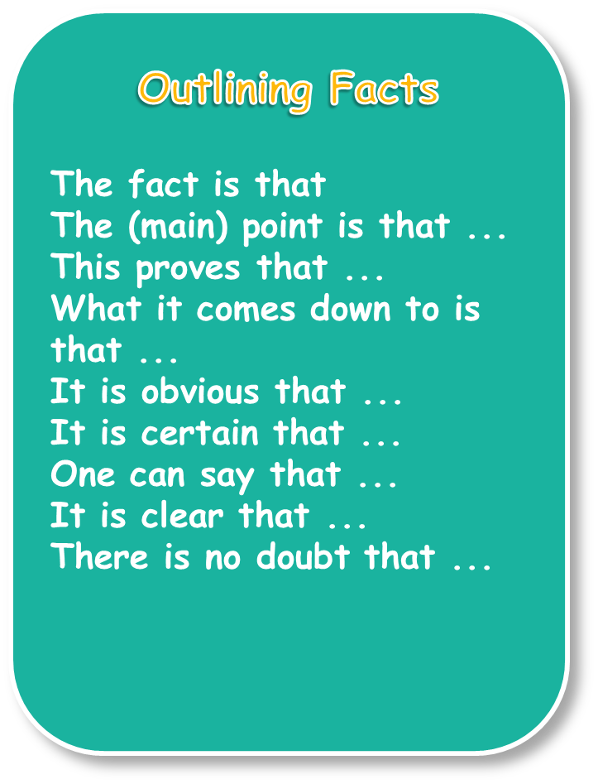
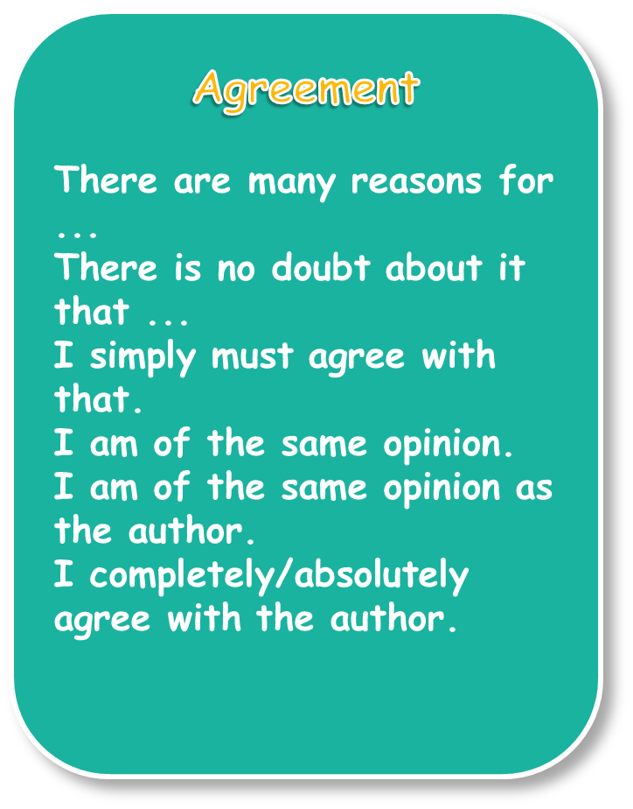

Slide 9
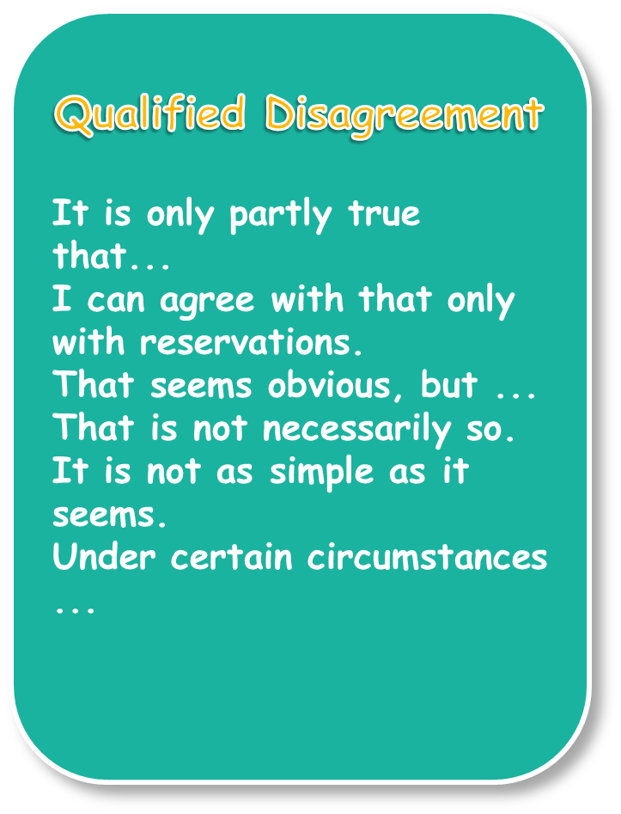
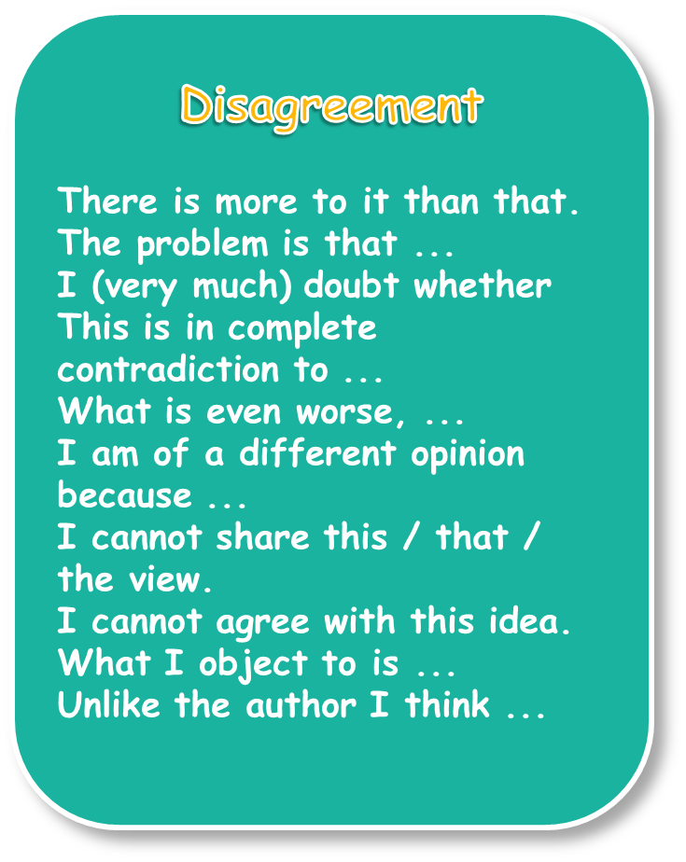

Slide 10

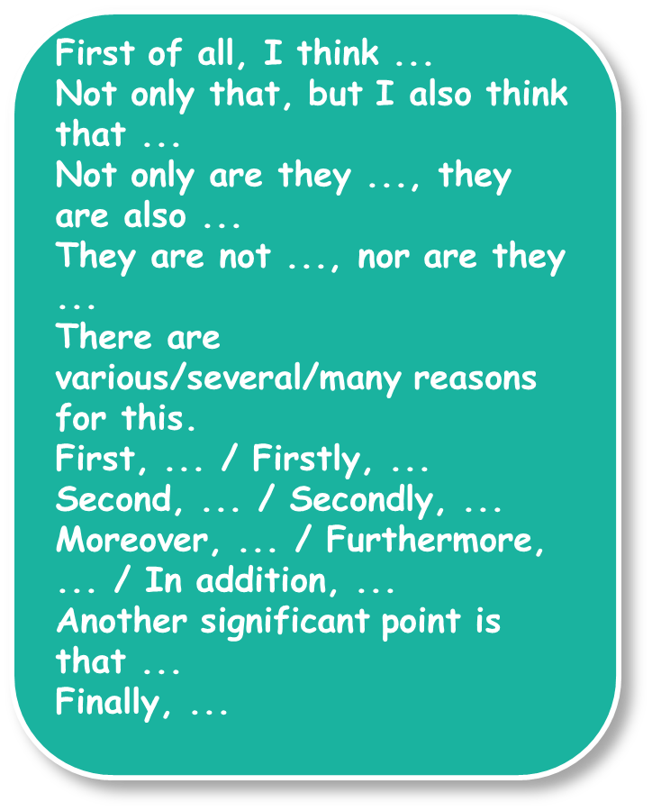
On the one hand, ... On the other hand, ...
In contrast to this is ...
Because of ...
That is why ...
After all, ...
The reason is that ...
In that respect ...
The result of this is that ...
Another aspect/point is that ...
It is because ...
Although it is true that ... it would be wrong to claim that ...
That may sometimes be true, but ...
One could argue that ..., but ...

Slide 11

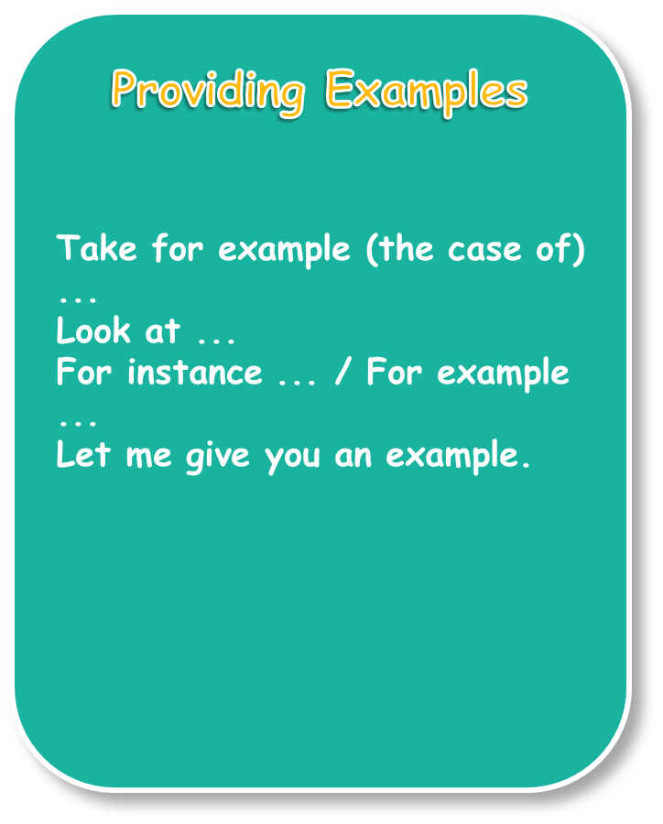
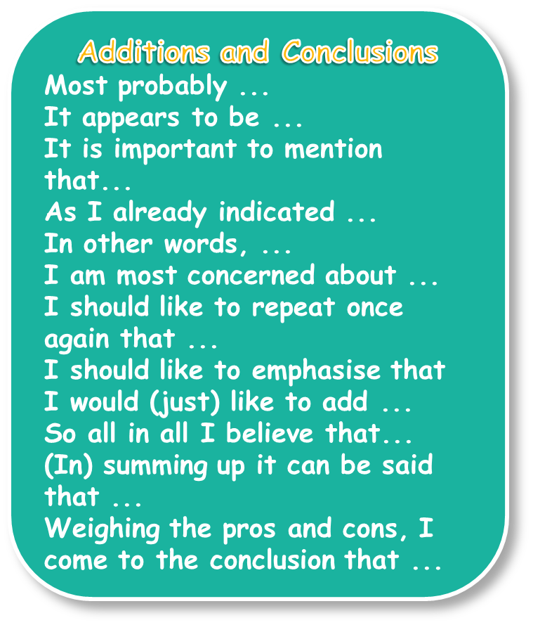

Slide 12

Use the linking words/phrases from the list below to fill in the table
that follows, as in the example.
in the first place, also, for example, to sum up, moreover, firstly, although, to begin with, all things considered, such as, therefore, on the other hand, however, apart from this, in other words, in particular, for instance, in addition, because, taking everything into account, furthermore, since, lastly, secondly, nevertheless, while
1. To list points:
2. To add more points:
3. To introduce opposing viewpoints:
4. To introduce examples / reasons:
5. To conclude:

Slide 13

Underline the correct word / phrase, as in the example.
1. It is argued / One reason that testing new drugs on animals is necessary before giving them to humans.
2. In my view, we can all do something to protect the environment. For example / In addition, we can recycle newspapers and magazines.
3. Taking holidays abroad is usually no more expensive that taking them in your own country. What is more, / However, it gives you the opportunity to experience other cultures.
4. Secondly / Especially, regular exercise helps you stay in good health.
5. On the other hand, it can be argued that what individuals do to protect the environment makes very little difference, in particular / since it is factories and power stations which create the most pollution.

Slide 14

Read the topic sentences and suggest suitable supporting details.
Television may have a harmful effect on young people.
________________________________________________________
________________________________________________________
Looking after the pet from an early age develops a person’s character.
________________________________________________________
________________________________________________________
Life in a large city is very interesting.
________________________________________________________
________________________________________________________

Slide 15

Read the paragraphs and arrange them in the correct order. Then label the paragraphs with the headings below.
3
second viewpoint and examples
5
restate opinion
2
first viewpoint and examples
1
subject and opinion
4
opposing viewpoints
Furthermore, it is essential to have a good knowledge of English and Maths in order to find even the simplest job. Reading, writing and mathematical skills are the minimum requirements that most employers demand.
On the one hand, it can be argued that Art and Music are just as significant as English and Maths. For instance, learning how to draw or play an instrument can introduce a child to a whole new world. In addition to this, subjects such as Art and Music can provide children with a well-rounded education rather than just basic skills.
All things considered, though, it seems to me that English and Maths are vital subjects. Without learning to read, write or do arithmetic, people may have difficulties coping with even the simplest tasks in daily life.
In the first place, when you know how to read, write and do simple calculations, you have the tools required in order to deal with everyday matters. For example, being able to read and write can help you communicate and express yourself clearly. Moreover, you need basic maths for such daily chores as doing your shopping, paying your bills and managing your money.
Isn’t it unfortunate that in today’s society there are so many people who cannot read, write or even do arithmetic. I strongly believe that, although subjects such as Art and Music are important, English and Maths are the most fundamental part of our education.

Slide 16
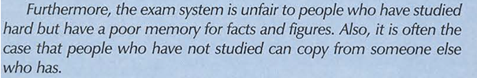
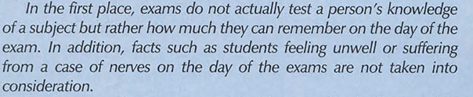
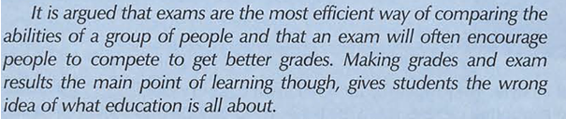



Slide 17
